Slide 1
CLOCK GENERATOR WITH ALARM
Khushi Baurasi
ECE – 211114213
NIT - BHOPAL

Slide 2
FEATURES
Clock generation.
Initializing clock time to a particular value.
Setting time for alarm.
Enabling and disabling alarm.
Stopping alarm.

Slide 3
BLOCK DIAGRAM
reset
clk
Alarm
H_in1
H_in0
H_out1
M_in1
H_out0
Alarm Clock
M_in0
M_out1
LD_time
M_out0
LD_alarm
S_out1
STOP_al
S_out0
AL_ON

Slide 4
FLOW CHART
YES
Set Alarm to zero.
Set time to the given input time.
RESET
NO
YES
NO
YES
Set time to the given input time.
Clk_1s
LD_alarm
LD_time
YES
NO
Set Alarm clock to the given input time
Clock operates normally by adding seconds.
Alarm_time==
real time
YES
Lower alarm Output.
YES
Raise alarm Output.
YES
STOP_al
AL_ON
NO

Slide 5
VERILOG CODE

Slide 6
module Aclock(
input reset,
input clk,
input [1:0] H_in1,
input [3:0] H_in0,
input [3:0] M_in1,
input [3:0] M_in0,
input LD_time,
input LD_alarm,
input STOP_al,
input AL_ON,
output reg Alarm,
output [1:0] H_out1,
output [3:0] H_out0,
output [3:0] M_out1,
output [3:0] M_out0,
output [3:0] S_out1,
output [3:0] S_out0);
reg clk_1s;
reg [3:0] tmp_1s;
reg [5:0] tmp_hour, tmp_minute, tmp_second;
reg [1:0] c_hour1,a_hour1;
reg [3:0] c_hour0,a_hour0;
reg [3:0] c_min1,a_min1;
reg [3:0] c_min0,a_min0;
reg [3:0] c_sec1,a_sec1;
reg [3:0] c_sec0,a_sec0;
Initialization
function [3:0] mod_10;
input [5:0] number;
begin
mod_10 = (number >=50) ? 5 : ((number >= 40)? 4 :((number >= 30)? 3 :((number >= 20)? 2 :((number >= 10)? 1 :0))));
end
endfunction
MOD 10 function

Slide 7
always @(posedge clk_1s or posedge reset )
begin
if(reset) begin
a_hour1 <= 2'b00;
a_hour0 <= 4'b0000;
a_min1 <= 4'b0000;
a_min0 <= 4'b0000;
a_sec1 <= 4'b0000;
a_sec0 <= 4'b0000;
tmp_hour <= H_in1*10 + H_in0;
tmp_minute <= M_in1*10 + M_in0;
tmp_second <= 0;
end
else begin
if(LD_alarm) begin
a_hour1 <= H_in1;
a_hour0 <= H_in0;
a_min1 <= M_in1;
a_min0 <= M_in0;
a_sec1 <= 4'b0000;
a_sec0 <= 4'b0000;
end
if(LD_time) begin
tmp_hour <= H_in1*10 + H_in0;
tmp_minute <= M_in1*10 + M_in0;
tmp_second <= 0;
end
else begin
tmp_second <= tmp_second + 1;
if(tmp_second >=59) begin
tmp_minute <= tmp_minute + 1;
tmp_second <= 0;
if(tmp_minute >=59) begin
tmp_minute <= 0;
tmp_hour <= tmp_hour + 1;
if(tmp_hour >= 24) begin
tmp_hour <= 0;
end
end
end
end
end
end
Loading and incrementing time

Slide 8
always @(posedge clk or posedge reset)
begin
if(reset)
begin
tmp_1s <= 0;
clk_1s <= 0;
end
else begin
tmp_1s <= tmp_1s + 1;
if(tmp_1s <= 5)
clk_1s <= 0;
else if (tmp_1s >= 10) begin
clk_1s <= 1;
tmp_1s <= 1;
end
else
clk_1s <= 1;
end
end
always @(*) begin
if(tmp_hour>=20) begin
c_hour1 = 2;
end
else begin
if(tmp_hour >=10)
c_hour1 = 1;
else
c_hour1 = 0;
end
c_hour0 = tmp_hour - c_hour1*10;
c_min1 = mod_10(tmp_minute);
c_min0 = tmp_minute - c_min1*10;
c_sec1 = mod_10(tmp_second);
c_sec0 = tmp_second - c_sec1*10;
end
assign H_out1 = c_hour1;
assign H_out0 = c_hour0;
assign M_out1 = c_min1;
assign M_out0 = c_min0;
assign S_out1 = c_sec1;
assign S_out0 = c_sec0;
always @(posedge clk_1s or posedge reset)
begin
if(reset)
Alarm <=0;
else begin
if({a_hour1,a_hour0,a_min1,a_min0,a_sec1,a_sec0}=={c_hour1,c_hour0,c_min1,c_min0,c_sec1,c_sec0})
begin / if(AL_ON) Alarm <= 1;
end
if(STOP_al)
Alarm <=0;
end
end
Setting and disabling alarm
Make 1s clock
Output time

Slide 9
SIMULATION OUTPUT

Slide 10
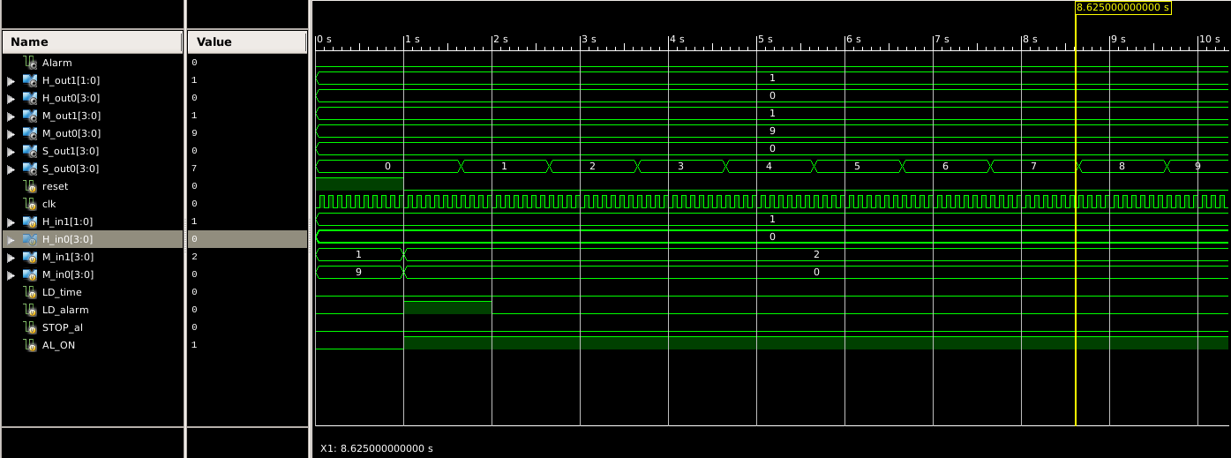
reset=1
LD_alarm=1

Slide 11
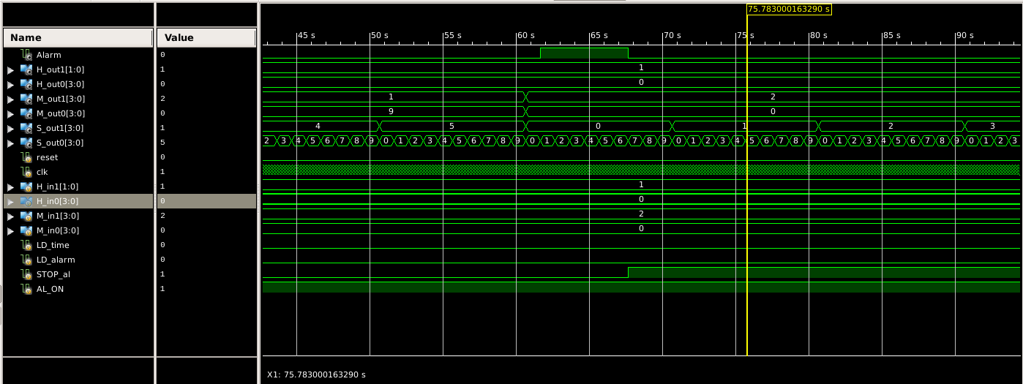
Alarm = 1
STOP_al = 1

Slide 12
THANK YOU!

